Slide 1
Contingent Capital with a Dual Price Trigger
-Robert L. McDonald
Feng-shang Ku

Slide 2
Background
The 2008 Financial Crisis has illustrated the fragility of financial institutions and the difficulty of resolving the commitments of institutions in distress.
One proposed reform is to have banks issue claims that behave like debt during normal times and which convert to equity during a crisis.
Bail-out
Bail-in
Contingent Capital

Slide 3
Abstract
This paper proposes a form of contingent capital for financial institutions that converts from debt to equity if two conditions are met:
1. the firm's stock price is at or below a trigger value
2. the value of a financial institutions index is also at or below a trigger value.
This paper discusses design goals for contingent capital, and outline some of the challenges in implementing contingent capital.

Slide 4
An Example of Contingent Capital With Dual
Market Triggers
Stock price of the bank : $100
the value at issuance of a broad financial firm index : 100
The bank issues a 5-year, $1000 par value bond(CC)
carrying a 6.25% rate of interest
under certain circumstances will convert into common equity.

Slide 5
For comparison, the risk-free rate is 6%. The bond will convert if two conditions are satisfied:
The stock price of the bank, appropriately adjusted for splits and stock dividends, falls below $50 (the stock trigger)
The value of the financial index falls below 90 (the index trigger)
Types of conversion :
Fixed share conversion : convert into a fixed number of shares
Fixed dollar conversion : convert into shares with a fixed dollar value
Par conversion : eg. a $1000 bond converts into $1000 of shares
Premium conversion : eg. a $1000 bond converts into $900 of shares
Discount conversion : eg. a $1000 bond converts into $1100 of shares

Slide 6
This structure accomplishes several things:
The conversion of bonds to shares occurs only if there is a widespread fall in the value of financial firm shares. One would expect such a widespread fall during a financial crisis, not at other times
A dual trigger convertible permits the failure of an institution as long as the financial industry as a whole is performing well. Without a fall in the index, bonds would not convert and the financial institution could go bankrupt.
There would be no regulatory involvement in the conversion decision
Conversion would not depend upon accounting rules or the institution's reported capital.

Slide 7
Discussion
Why contingent capital instead of equity?
Market Manipulation
Multiple Equilibria
Delta-Hedging
Type I and Type II Errors
The Use of Accounting Measures
Pricing Example

Slide 8
Why contingent capital instead of equity?
Opponents of an increase in the capital ratio commonly argue that equity capital is expensive.
Tax-deductibility
Because it pays interest, contingent capital can discipline management, and thus can play a government role.

Slide 9
Market Manipulation
During the financial crisis both regulators and market participants expressed concern about market manipulation.
There are two distinct questions:
whether the trader can affect the price of an asset
  (for example drive it down by selling)
whether the trader can profit from affecting the asset price

Slide 10
Market Manipulation
Firm Stock Price Manipulation
Index Price Manipulation
Manipulation of the Bankruptcy Process
Design Implications

Slide 11
Firm Stock Price Manipulation
One important concern is a scenario in which an arbitrageur would buy the contingent convertible, short-sell the stock to push its price down into the conversion region, convert, and benefit from the gain on the newly converted share as the stock returns to its "correct" level above the trigger price
Fixed share vs. fixed dollar conversion

Slide 12
Index Price Manipulation
Another manipulation scenario arises if the index trigger condition is not met but the stock price trigger is met. In this case, by the time the index falls enough to permit conversion, the conversion value of the stock can be much less than $1000( 20 shares * $50 per share).
To reduce the effect of this knife-edge case, the index conversion trigger could be based on an n-days average of the index.
It would be possible to use different conversion methods depending upon which trigger is hit first.

Slide 13
Manipulation of the Bankruptcy Process
Under some circumstances bondholders could have an incentive to try to force the institution into bankruptcy before conversion can occur.
Ex.
Suppose the share price is very low but the index price is above the trigger. Bondholders may believe that they will receive a greater percentage of principal as subordinated bondholders in bankruptcy as opposed to the value of shares they would receive in default.

Slide 14
Design Implications
This discussion suggests that it is possible to reduce the potential impact of manipulation by doing the following:
Use a fixed share conversion
Have the shares convert at a premium (the value of newly converted shares is worth less than the par value of the bond)
Have the index conversion condition be based on an average price over time
Retire bonds gradually and randomly as maturity approaches in order to avoid the very large gains from manipulation that can occur at maturity

Slide 15
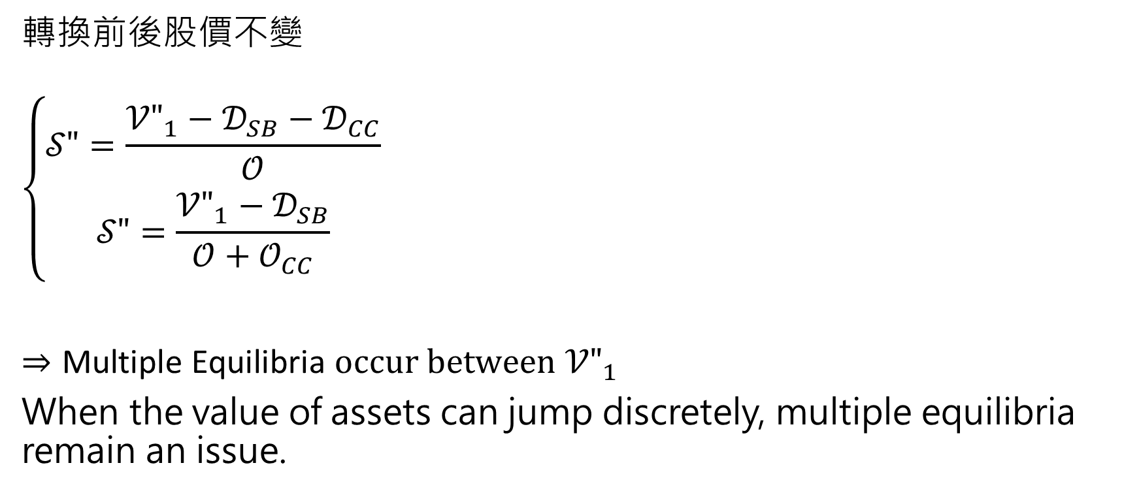
Multiple Equilibria
轉換前後股價不變
$$\left\{\begin{aligned}𝒮"=\frac{{𝒱"}_{1}−𝒟_{SB}−𝒟_{CC}}{𝒪} \\ 𝒮"=\frac{{𝒱"}_{1}−𝒟_{SB}}{𝒪+𝒪_{CC}}\end{aligned}\right.$$
$⇒\text{Multiple} \text{Equilibria} occur between$ ${𝒱"}_{1}$
When the value of assets can jump discretely, multiple equilibria remain an issue.

Slide 16
Delta-Hedging
Delta-hedging refers to a situation where a trader holds a position in a contingent claim and hedges that claim using the underlying asset.
For example, the owner of a convertible bond could short a particular number of shares to hedge the bond.
Short-selling has cost and the possibility of jumps reduces the effectiveness of delta-hedging.

Slide 17
Type I and Type II Errors
Any contingent capital scheme can fail. The language of statistical hypothesis testing provides terminology for a discussion of failure.
Type I Errors
  Contingent capital converts when capital is not required
Type II Errors (more concerning)
  Contingent capital does not convert when the bank requires capital

Slide 18
Type I Errors
The bank should be able to repurchase the newly converted shares and fund this repurchase with a new issue of contingent capital or other security.
Transactions that unwind a conversion will carry transaction costs, but it is not necessary for the bank to undo the conversion immediately.

Slide 19
Type II Errors-1
For a market-based trigger, there are at least two obvious failure scenarios:
Markets might shut down, so that no equity price is observable. This contingency would need to be dealt with at the outset in the contingent capital documentation.
The anticipation of government action to rescue the financial system could prevent share prices from falling.

Slide 20
Type II Errors-2
For a regulatory trigger, failure scenarios include :
Regulators might fail to take prompt action. This could occur because regulators deem action unnecessary, because legislators interfere with regulation, or because regulatory squabbles create gridlock.
Regulatory measures might not permit action. For example, if regulatory capital is mismeasured, it might be impossible for regulators to act when it otherwise seems clearly desirable.
Regulatory action could take time

Slide 21
The Use of Accounting Measures
Most accounting is done periodically rather than continuously.
Accounting rules are subject to political pressure
Accounting rules are subject to arbitrage.
Accounting measures are often backward-looking
One way to summarize this discussion is to say that accounting system gives banks an option.If they are unhappy with the outcome in a particular state of nature, it’s possible for them to lobby both regulatory and accounting authorities.

Slide 22
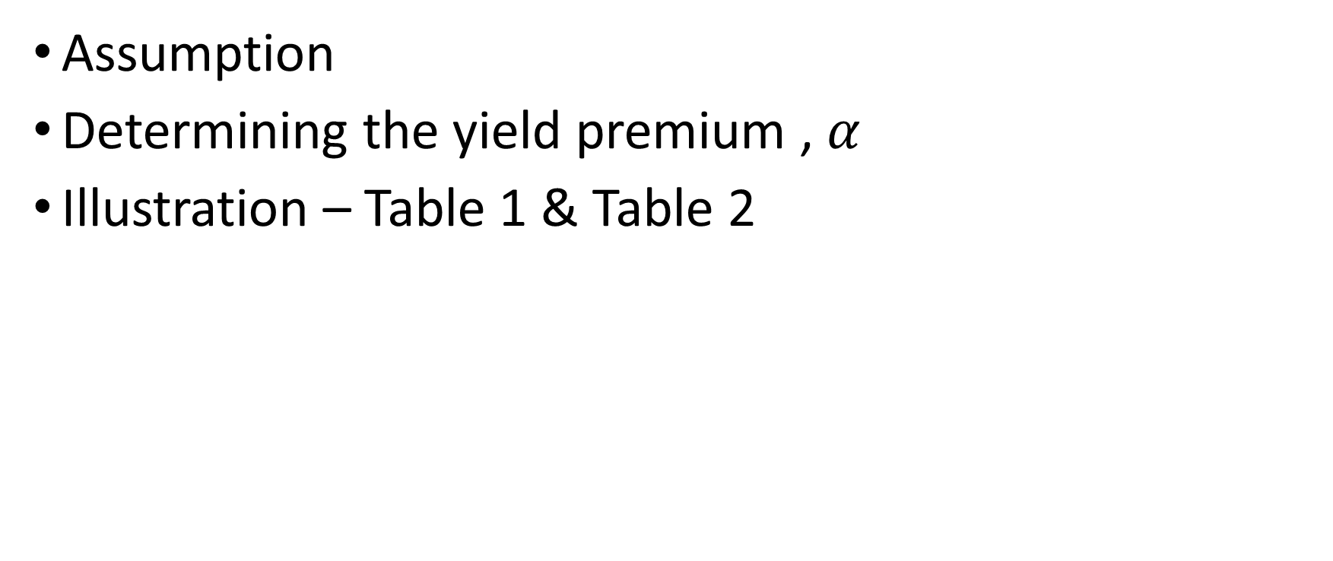
Pricing Example – Pricing the Contingency Convertible
Assumption
Determining the yield premium , $α$
Illustration – Table 1 & Table 2

Slide 23
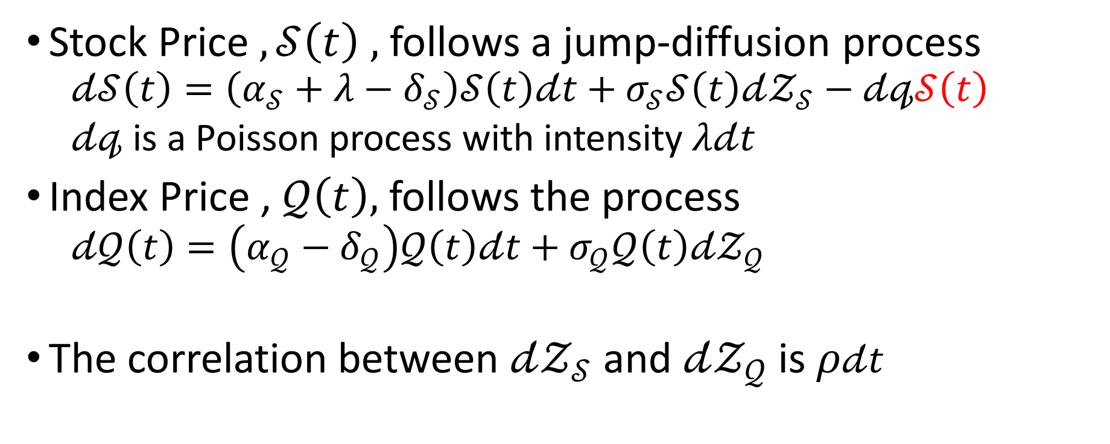
Assumption
Stock Price $,𝒮\left(t\right) ,$ follows a jump-diffusion process
  $$𝒹𝒮\left(t\right)=\left(α_{𝒮}+λ−δ_{𝒮}\right)𝒮\left(t\right)𝒹t+σ_{𝒮}𝒮\left(t\right)𝒹𝒵_{𝒮}−𝒹𝓆𝒮\left(t\right)$$
  $𝒹𝓆$ is a Poisson process with intensity$λ𝒹t$
Index Price , $𝒬\left(t\right),$follows the process
  $$𝒹𝒬\left(t\right)=\left(α_{𝒬}−δ_{𝒬}\right)𝒬\left(t\right)𝒹t+σ_{𝒬}𝒬\left(t\right)𝒹𝒵_{𝒬}$$
  The correlation between $𝒹𝒵_{𝒮}$ and $𝒹𝒵_{𝒬}$ is $ρ𝒹t$

Slide 24

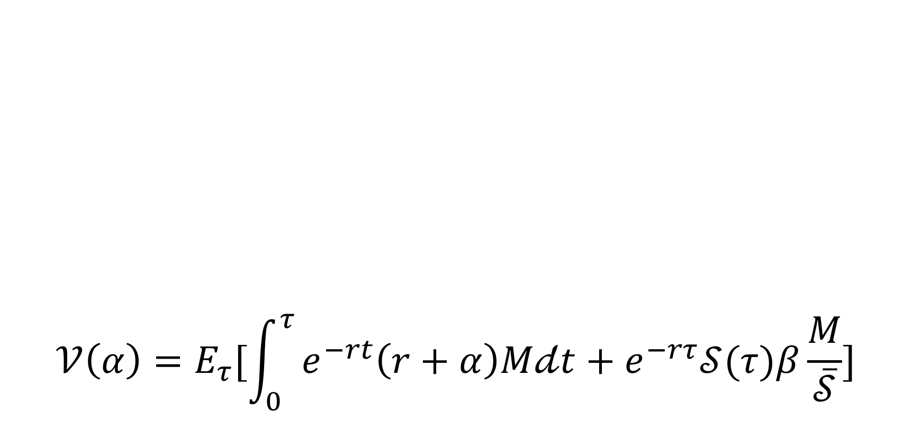
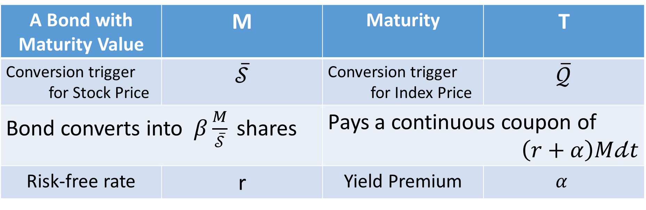
Determining the yield premium , $α$
A Bond with Maturity Value | M | Maturity | T
Conversion trigger for Stock Price | $$\overline{𝒮}$$ | Conversion trigger for Index Price | $$\overline{𝒬}$$
Bond converts into $β\frac{M}{\overline{𝒮}}$ shares |  | Pays a continuous coupon of $\left(r+α\right)M𝒹t$
Risk-free rate | r | Yield Premium | $$α$$
$$𝒱\left(α\right)=E_{τ}[\int_{0}^{τ}{e^{−rt}\left(r+α\right)M𝒹t+e^{−rτ}𝒮(τ)β\frac{M}{\overline{𝒮}}}]$$

Slide 25
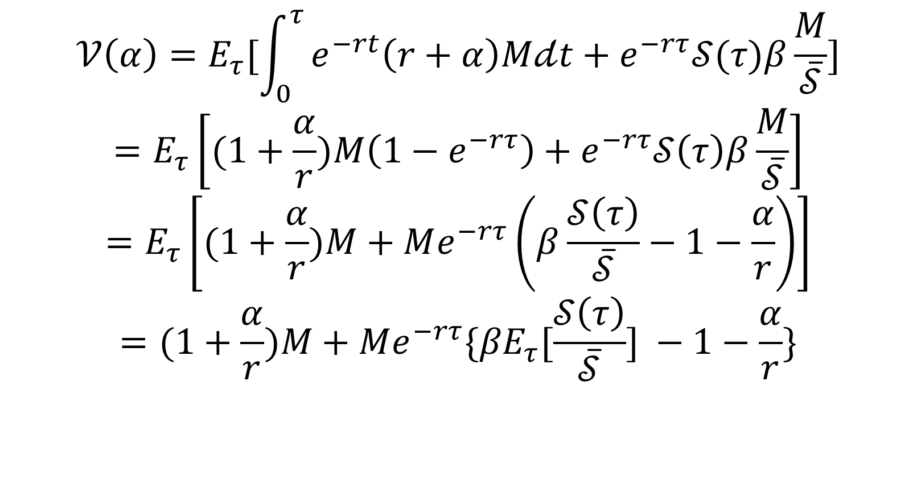

Determining the yield premium , $α$
$$𝒱\left(α\right)=E_{τ}[\int_{0}^{τ}{e^{−rt}\left(r+α\right)M𝒹t+e^{−rτ}𝒮(τ)β\frac{M}{\overline{𝒮}}}]$$
$$=E_{τ}\left[(1+\frac{α}{r})M\left(1−e^{−rτ}\right)+e^{−rτ}𝒮\left(τ\right)β\frac{M}{\overline{𝒮}}\right]$$
$$=E_{τ}\left[(1+\frac{α}{r})M+Me^{−rτ}\left(β\frac{𝒮\left(τ\right)}{\overline{𝒮}}−1−\frac{α}{r}\right)\right]$$
$$=(1+\frac{α}{r})M+Me^{−rτ}{\{βE}_{τ}[\frac{𝒮\left(τ\right)}{\overline{𝒮}}] −1−\frac{α}{r}\}$$

Slide 26
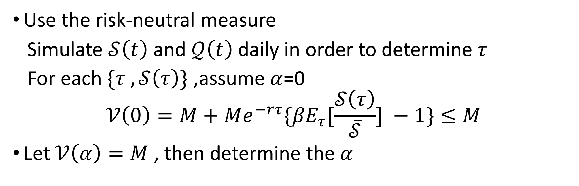

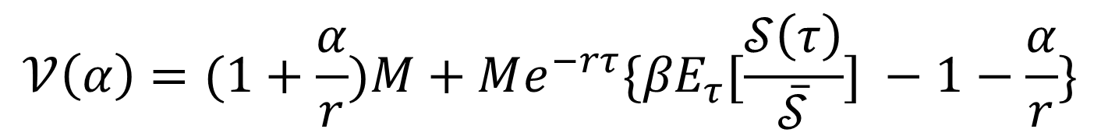
Determining the yield premium , $α$
$$𝒱\left(α\right)=(1+\frac{α}{r})M+Me^{−rτ}{\{βE}_{τ}[\frac{𝒮\left(τ\right)}{\overline{𝒮}}] −1−\frac{α}{r}\}$$
Use the risk-neutral measure
Simulate $𝒮\left(t\right)$ and $𝒬\left(t\right)$ daily in order to determine$τ$
For each $\{τ ,𝒮\left(τ\right)\}$ ,assume$α$=0
$$𝒱\left(0\right)=M+Me^{−rτ}{\{βE}_{τ}[\frac{𝒮\left(τ\right)}{\overline{𝒮}}] −1\}≤M$$
Let $𝒱\left(α\right)=M$ , then determine the$α$
$$𝒮\left(τ\right)≤\overline{𝒮}$$

Slide 27
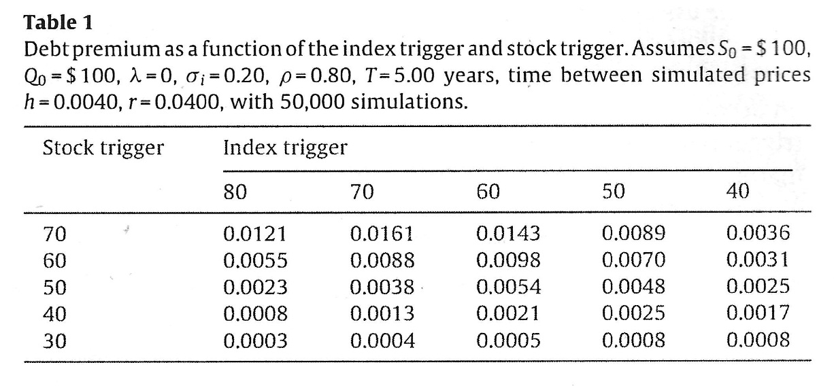
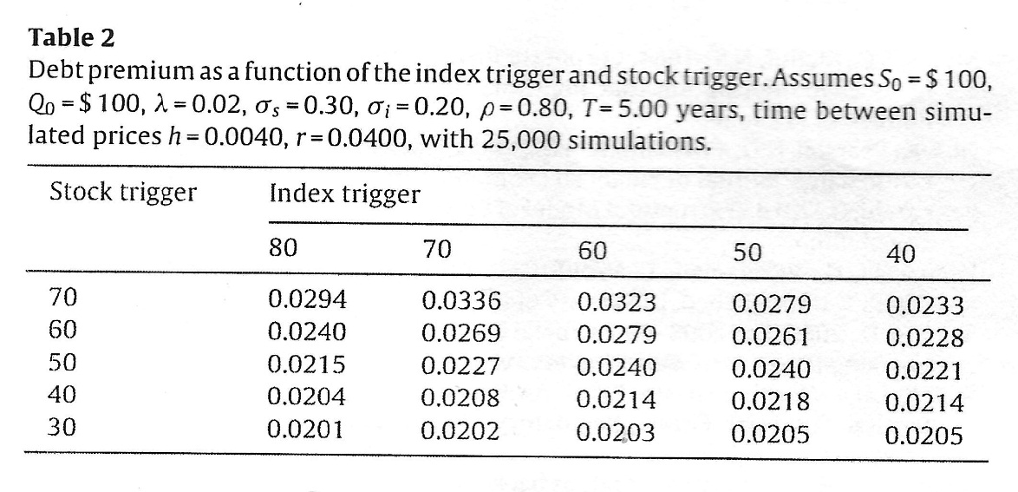
Illustration – Table 1 & Table 2
Result
The table reports the annual yield premium above the risk-free rate.
If the triggers are equal ,the stock is likelier to reach its trigger before the index reaches its trigger.
Moving further to the right ,conversion becomes less likely ,and thus the yield decreases. | When the conversions trigger are low and unlikely to be hit ,there is a 2% chance that the bond will default and pay zero. This gives rise to yields of about 2% in the bottom row of the table ,where the stock trigger is $30.

Slide 28
Conclusion
The primary benefits are the complete reliance on market prices as opposed to accounting numbers or regulatory pronouncements of crisis.
The claim also permits bankruptcy for a bank performing badly in good times.
An important disadvantage is the possibility of multiple equilibria. The design that minimizes the chance of multiple equilibria is prone to manipulation.

Slide 29
The End

